Slide 1
Warhammer 40K Unit Efficiency Calculator
By: Frederick Zuberer, Dan Maher, Anthony Telerico, Winson Li

Slide 2
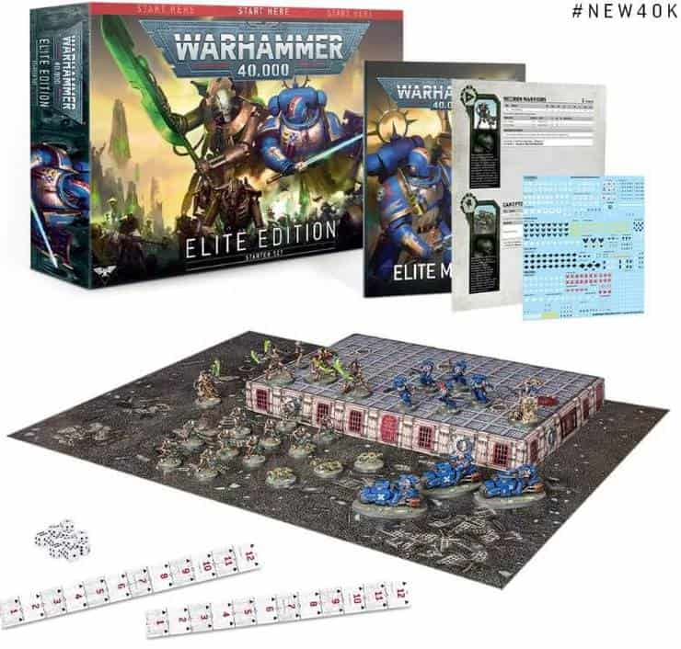
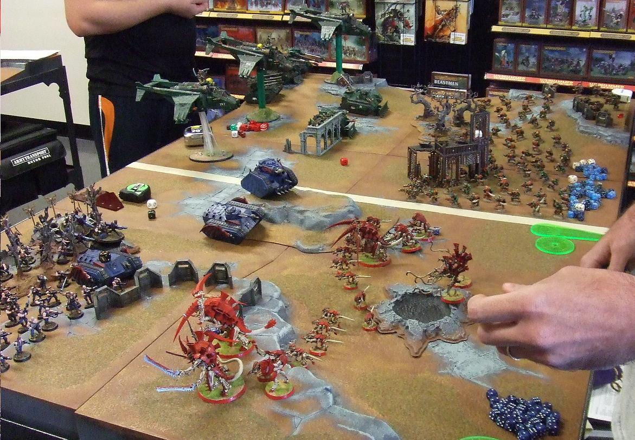
Warhammer 40K
What is Warhammer?
The most popular miniature tabletop wargame in the world
Using model soldiers, vehicles, and terrain, players construct the ‘battlefield’
Uses six-sided dice, a game based upon random probability and statistical outcomes

Slide 3

Problem Statement
Avoiding “Mathhammer”
Players are expected to:
Calculate the expected average outcome of attacks
Make informed strategic battle decisions
Evaluate purchases of physical models based on their possible effectiveness

Slide 4

Application Usage and Aim
The Warhammer 40K Unit Efficiency Calculator is a tool to help Warhammer 40k players find the efficiency of their units by calculating the statistical average damage done to targets by a unit.
Users are expected to have basic understanding and familiarity with the rules and mechanics of the 40k.

Slide 5

Customer
Shieldwall Gaming Club in Willoughby
Plans on using our application for casual Warhammer games and tournament play

Slide 6
Systems Requirements and Elicitation
Must have an easy to use and simple interface
Main functionality must be available offline
Results must be fast and accurate
Terms and definitions must be available for new players
Must be compatible with the ninth edition of the game

Slide 7
Project Organization, Communication, and Development
Github
https://github.com/dev-proj-warhammer-40k/40K-Probability-Calculator
Google Drive
Discord
Android Studio (Java)

Slide 8
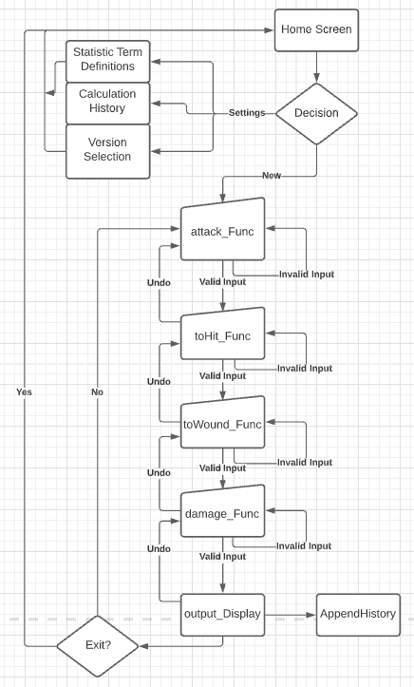
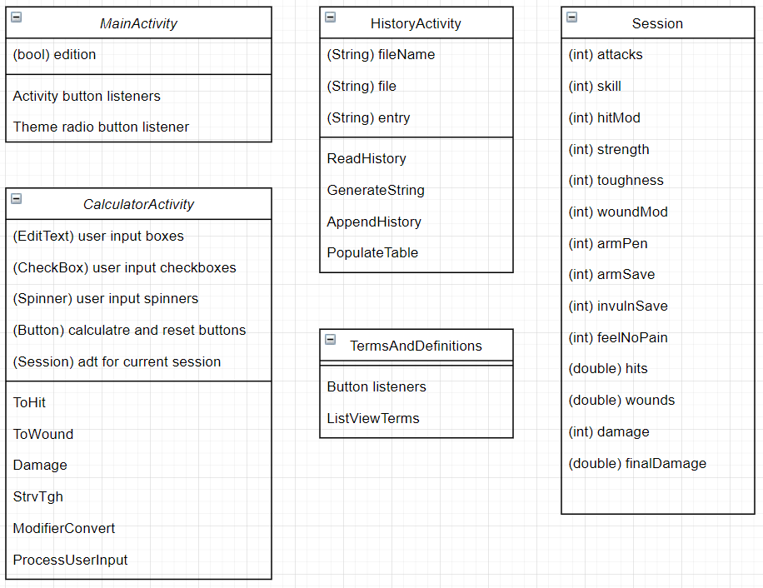
Structure and Program Flow

Slide 9
Challenges & To-Do
Challenges
Learning Java
Learning Android Development
Learning Git within a team environment
To-Do
Improve history logging capabilities
Test on multiple platforms, confirm compatibility
IOS version
Further compatibility with previous game editions

Slide 10
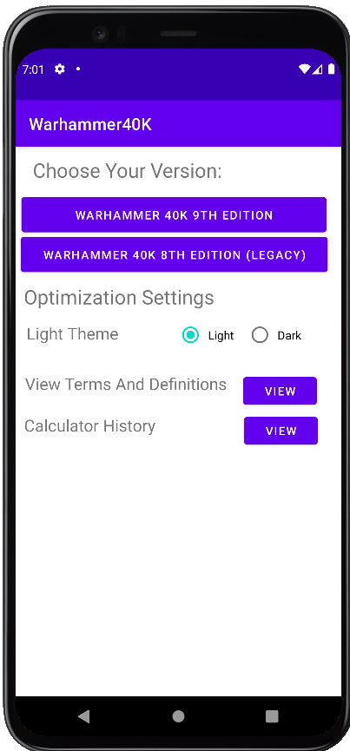
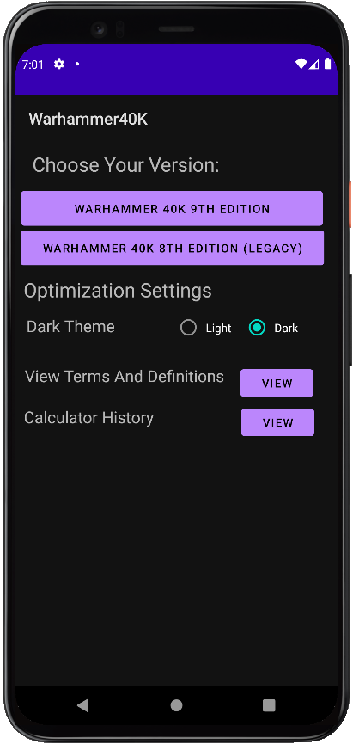
Application Screens and Features
Version Selection and Settings Screen
9th Edition Calculator
8th Edition Calculator
Light and Dark Mode
View Terms and Definitions
Calculator History

Slide 11
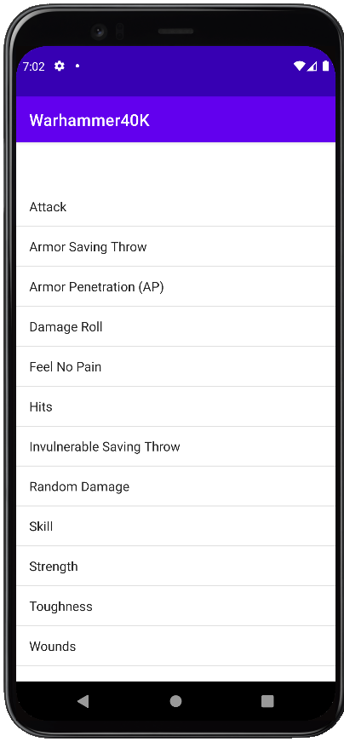
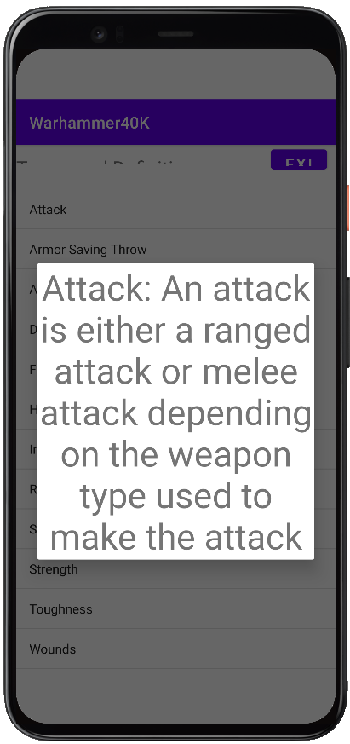
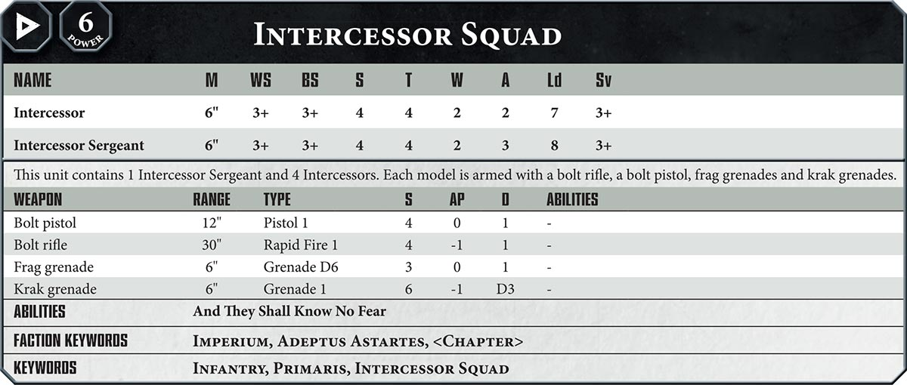
Application Screens and Features
By tapping on view for View Terms and Definition, the user will be brought to a list of relevant terms referred to by the calculator and will be able to view each terms’ definitions.

Slide 12
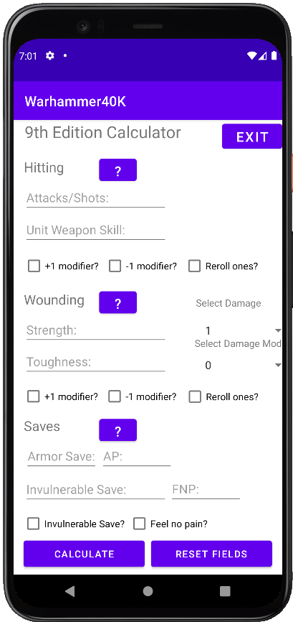
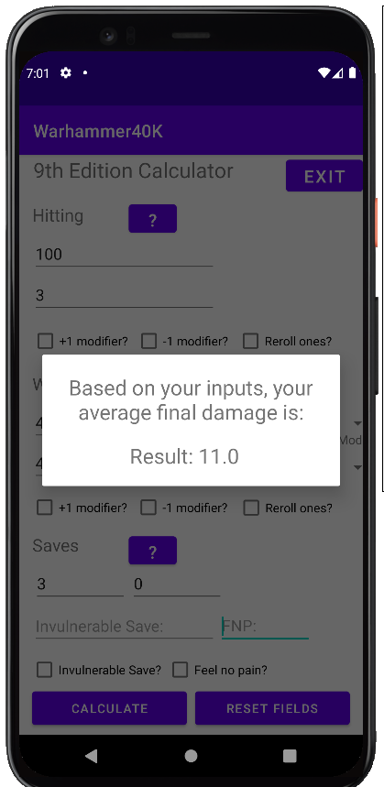
Application Screens and Features
9th Edition Calculator
Fast and easy to use, all input on the screen, step-by-step
Tapping on the ‘?’ button gives help via definitions
Error Handling: If the user inputs are invalid, a message will pop up alerting them of the error and how to correct it.

Slide 13

Application Screens and Features
Eighth Edition Calculator
The +1/-1 modifier checkboxes are replaced with modifier input boxes
The function flow is slightly difference

Slide 14
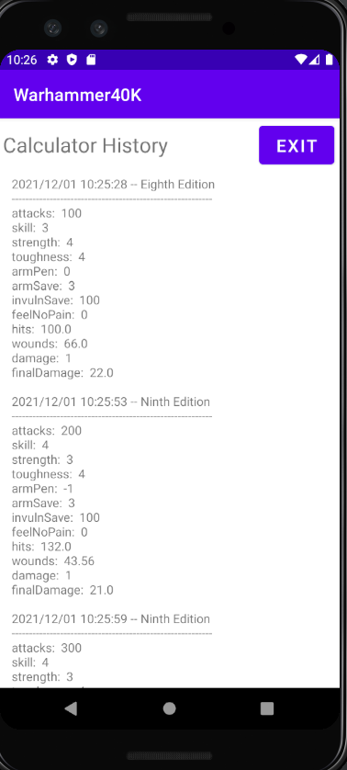
Application Screens and Features
Calculator History
Saves user inputs and the outputs of the calculator to an internal text file
Useful for quick and easy reference
Future Updates
Generate table from file, instead of reading the .txt file directly
Ability to name saved calculations for easier reference
Ability to clear log, or individual entries, without clearing app cache

